Slide 1
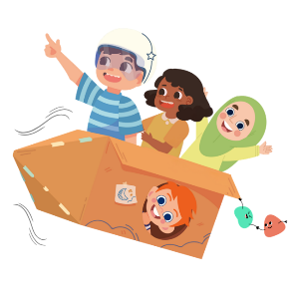
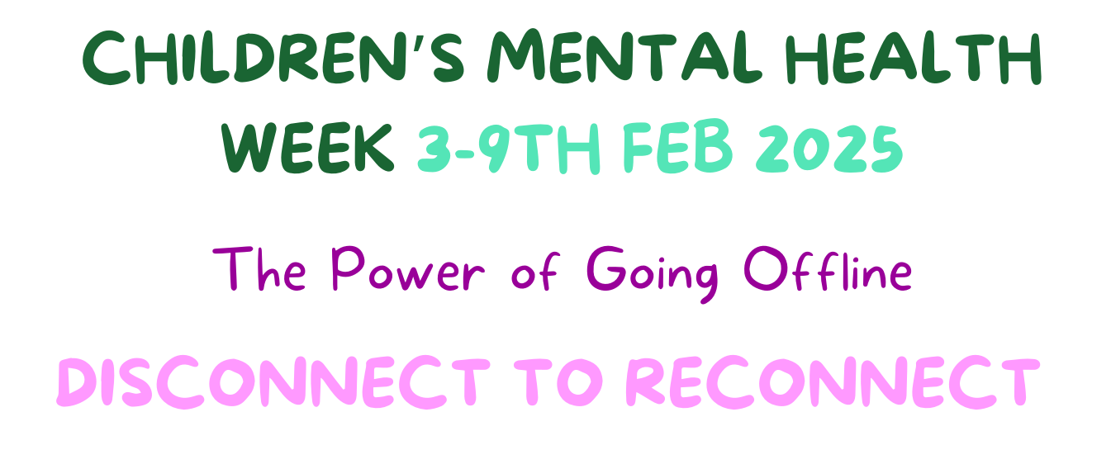

Slide 2
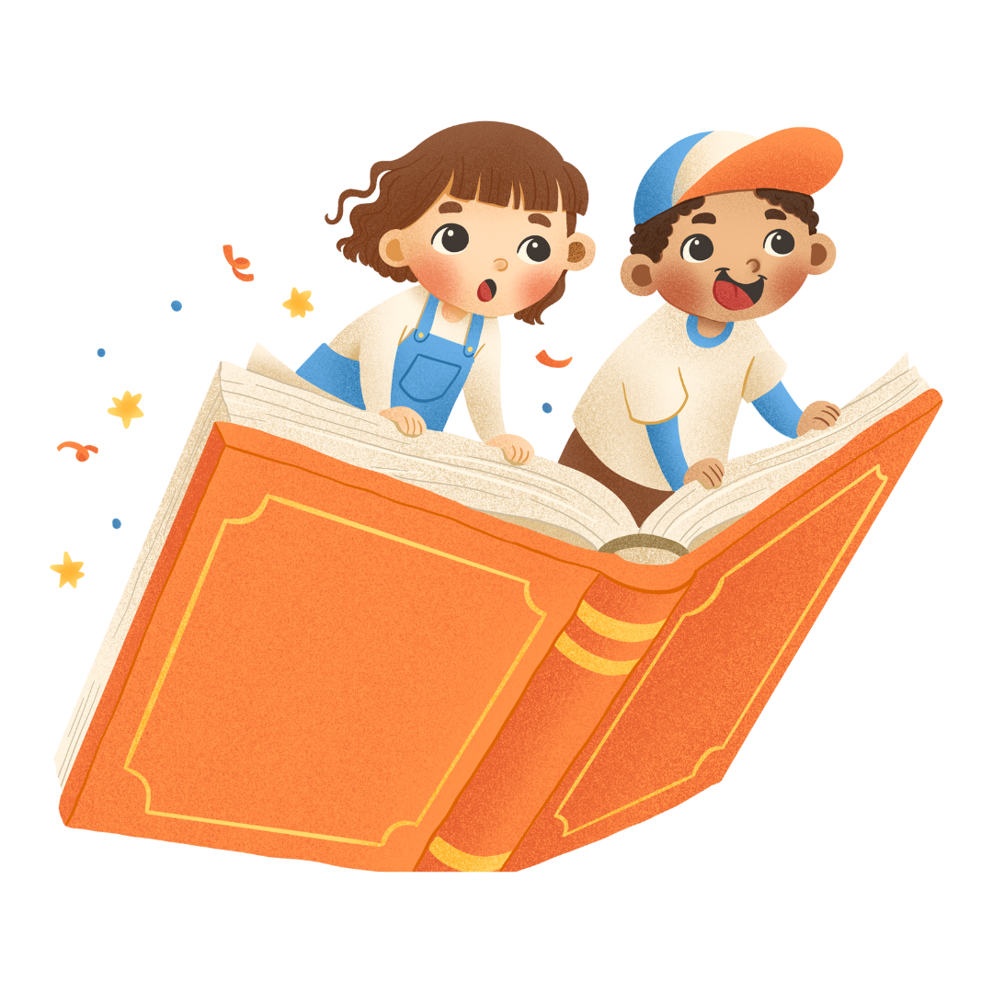
This year our theme is:
This year we want to encourage you to DISCONNECT from your digital devices and RECONNECT with the world around you.
Our digital devices, like our mobiles and iPads, provide us with entertainment and distraction. However, TOO MUCH time on our digital devices can become unhealthy, leaving us disconnected.
Notes:
So why has UP chosen this theme?
Our digital devices such as our mobile phone, Ipad, laptop, and gaming devices can help us stay connected to our families, friends, interests and our online world.
However, TOO MUCH time on our digital devices can become unhealthy, leaving us disconnected from the real world and the people closest to us.
This year we want to encourage you to DISCONNECT from your digital devices and RECONNECT with the world around you, to help build better connections and a healthier relationship with your digital devices.

Slide 3
Children’s Mental Health Week Explained
Explanation: Screen-free activities at home can encourage family bonding, boost creativity, improve focus, and help children develop social and emotional skills. By engaging in hands-on activities and real-world experiences, children can strengthen their connections with loved ones and enjoy learning and playing in a more balanced way. These activities can be done as short breaks or longer family time together.
Aim: To promote the importance of taking regular tech breaks and inspire families to engage in screen-free, meaningful activities that foster creativity, connection, and well-being at home.
Learning Objective: Parents will understand the benefits of reducing screen time for their children, explore alternative activities that boost creativity and mental health, and develop strategies for incorporating regular screen-free periods into family life.

Slide 4
Does your child...
Spend more than 2 hours a day on your devices?
Find everything else is BORING except your devices?
Find it hard to concentrate, sleep, and relax?
Or even prefer being on a device instead of spending time with your family/friends?
These can all be signs that your child is having too much screen time

Slide 5
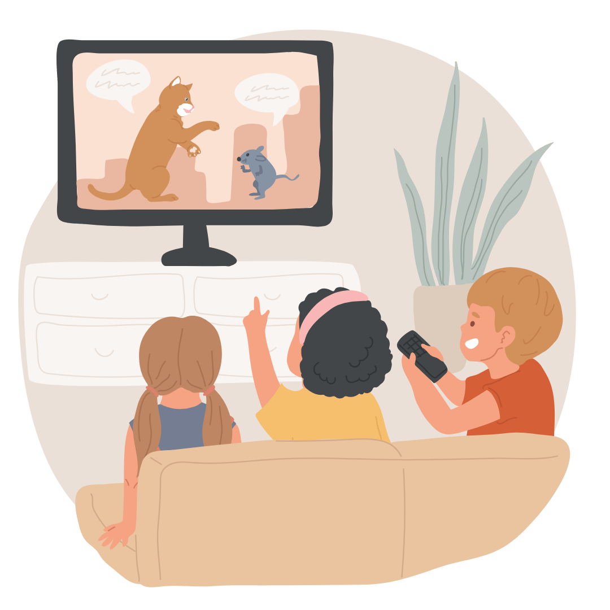
What are healthy digital habits?
Setting boundaries and daily limits:
This helps maintain a healthy relationship with your devices and supports your mental wellbeing. It allows you to be more physically active and free.
Using screens together:
Watch, play, and talk together about what is on the screen, this enables you engage with the digital and real world in a healthier way. It also means you can share your joy and interest with friends/family.
Screen free play:
Improves your social skills, your communication and boosts your creativity and imagination and happy hormones. It will also learn how to navigate conflict and relationship repair.
Device free bedtimes:
This will help you relax, improve your sleep, wellbeing and concentration.

Slide 6
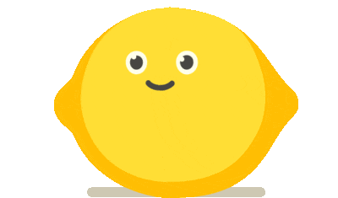
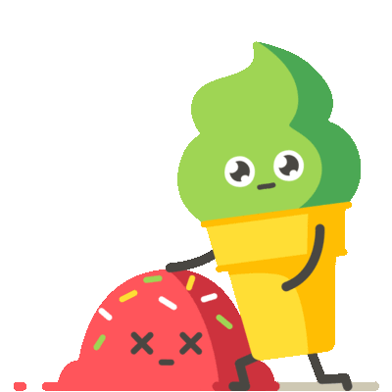
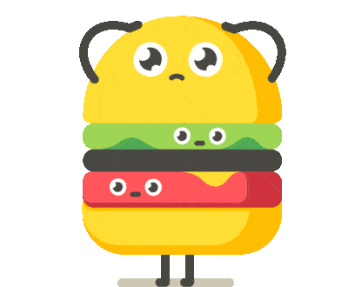
The Science Behind It
Taking care of your brain’s hormones is important for us, because these hormones help you know when something is fun and exciting, as well as making us feel good. These hormones are called:
Dopamine: Dopamine is the happy chemical that makes you feel good when you enjoy something, like eating your favourite snack or playing a game. But if you use things like your digital devices or apps too much, it might be harder to stop using them, and it will also make other things seems boring.
Serotonin: Serotonin helps keep your mood balanced. If you don’t have enough, you might feel sad when you're not meant to, especially if you use technology too much, because it can sometimes drain your happy hormones.
Cortisol: Cortisol is the stress hormone this helps you react to scary or stressful things. But it can also make you feel stressed when you stop using things you like, for example, your digital devices or games. Which makes it hard to enjoy other things or be present.
This is why balancing screen time with other fun activities will keep your brain happy and healthy!

Slide 7
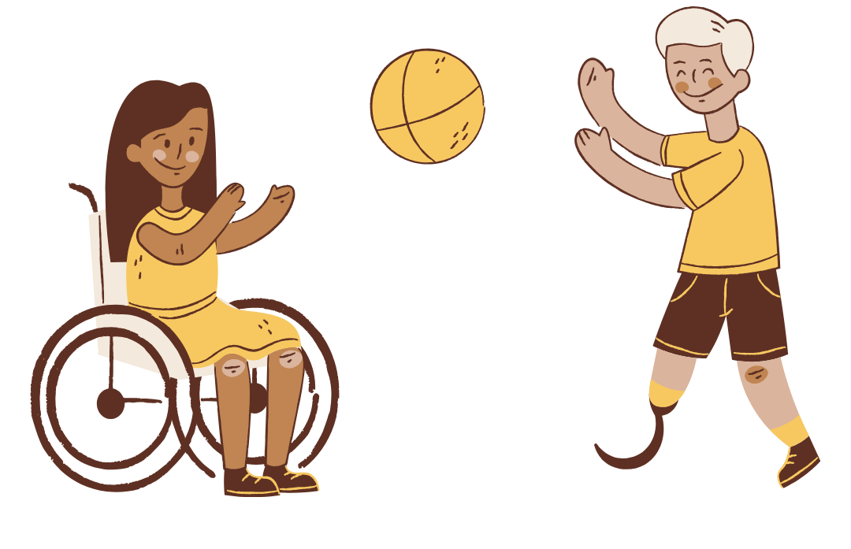
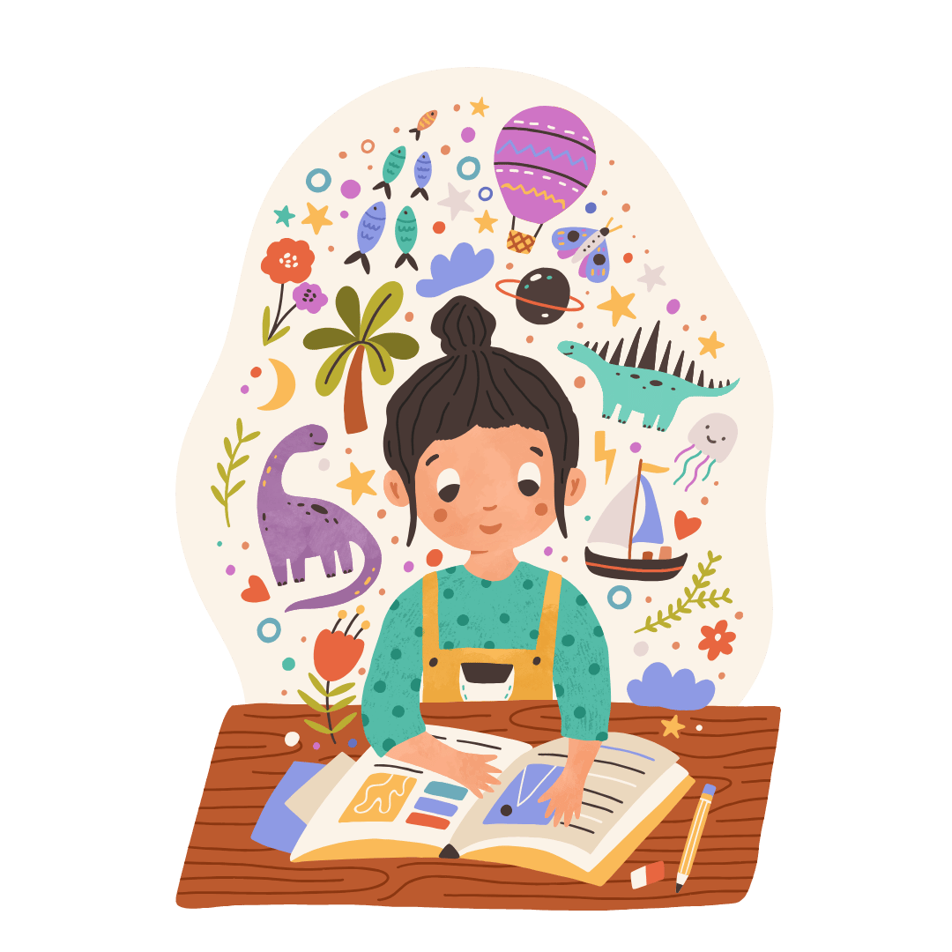
What can we do to reduce their screen time?
Setting boundaries and daily limits
Device free bedtimes
Play screen free sports
Play with friends
Screen free creative activities

Slide 8
Nature Treasure Hunt
What to Do: Create a simple list of things to find outside, like a feather, a yellow leaf, a smooth stone, or a flower. Head to the garden, park, or local woods and let the kids explore! Why It’s Fun: Encourages curiosity, gets everyone moving, and sparks conversations about nature. Bonus: Let them collect items to create a nature collage later!
Build a Fort
What to Do: Gather blankets, cushions, and chairs to build a cosy fort in your living room or garden. Decorate it with fairy lights or pillows, and turn it into a reading nook or pretend castle. Why It’s Fun: It’s creative, collaborative, and offers endless imaginative play opportunities. Bonus: Bring in a few books or toys for extra entertainment in the fort!
Bake together
Choose a simple recipe like cookies, cupcakes, or pancakes, and bake together as a family. Let the kids help measure, mix, and decorate. It’s hands-on, creative, and a great way to teach children basic cooking skills and teamwork. Plus, you get a delicious treat to enjoy together at the end! Bonus: Use this time to talk about favourite flavours, share stories, or even make up a fun name for your creation.

Slide 9
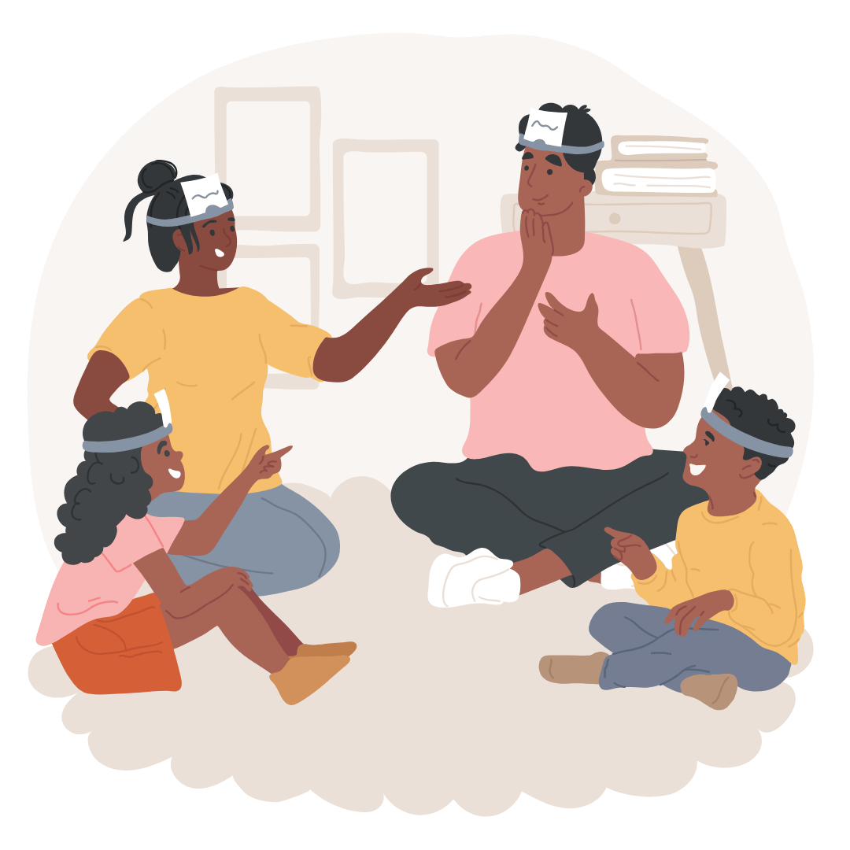
Who Am I?
What You Need:
Sticky notes or small pieces of paper
Pen
How to Play:
Write the name of a famous person, animal, or character on a sticky note and stick it on someone else’s forehead without letting them see it.
Each player takes turns asking "yes" or "no" questions to figure out who they are.
Example: "Am I a person?" "Am I in a movie?"
Keep going until everyone has guessed their identity.

Slide 10
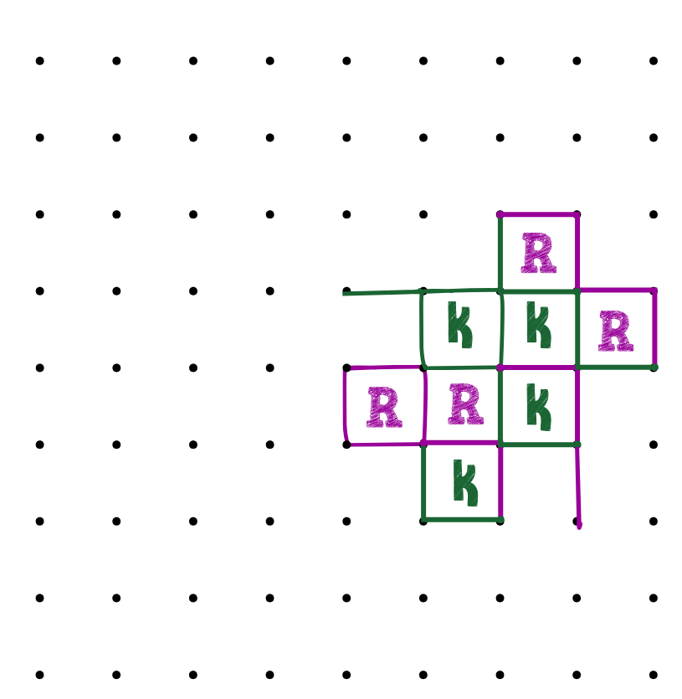
Dots & Boxes
What You Need:
Paper
Pencil
How to Play:
Draw a grid of dots (e.g., 6x6 or more, depending on how long you want to play).
Players take turns drawing one line between two dots (horizontally or vertically).
When a player completes a square, they write their initial in the box and take another turn.
Keep playing until all the squares are filled. The player with the most squares wins!

Slide 11
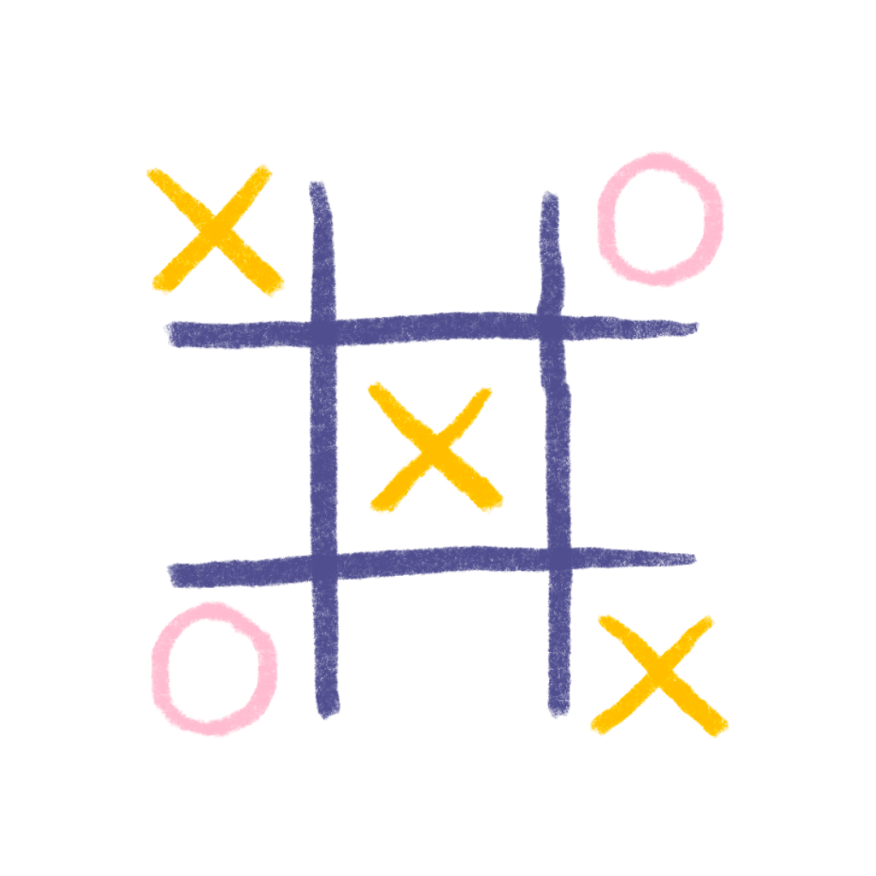
Noughts & Crosses
What You Need:
Paper
Pencil
How to Play:
Draw a grid with 3 rows and 3 columns (a total of 9 squares).
One player is "X," and the other is "O."
Take turns placing your symbol in an empty square.
The goal is to get three of your symbols in a row (horizontally, vertically, or diagonally).
The first to do so wins! If all squares are filled with no winner, it’s a draw.

Slide 12
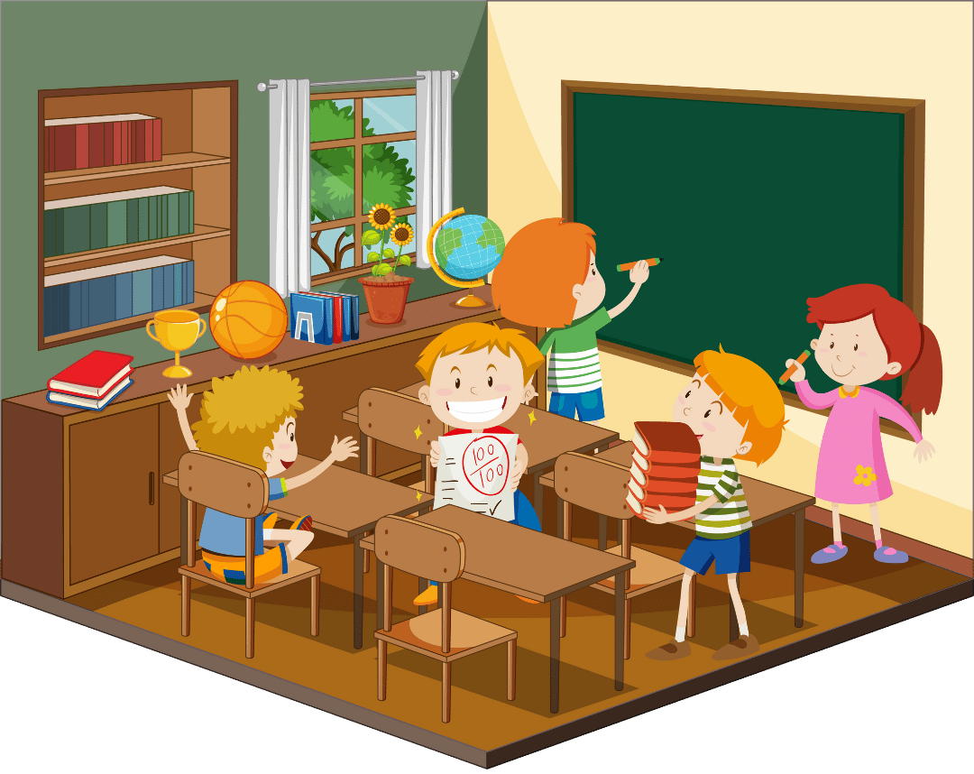
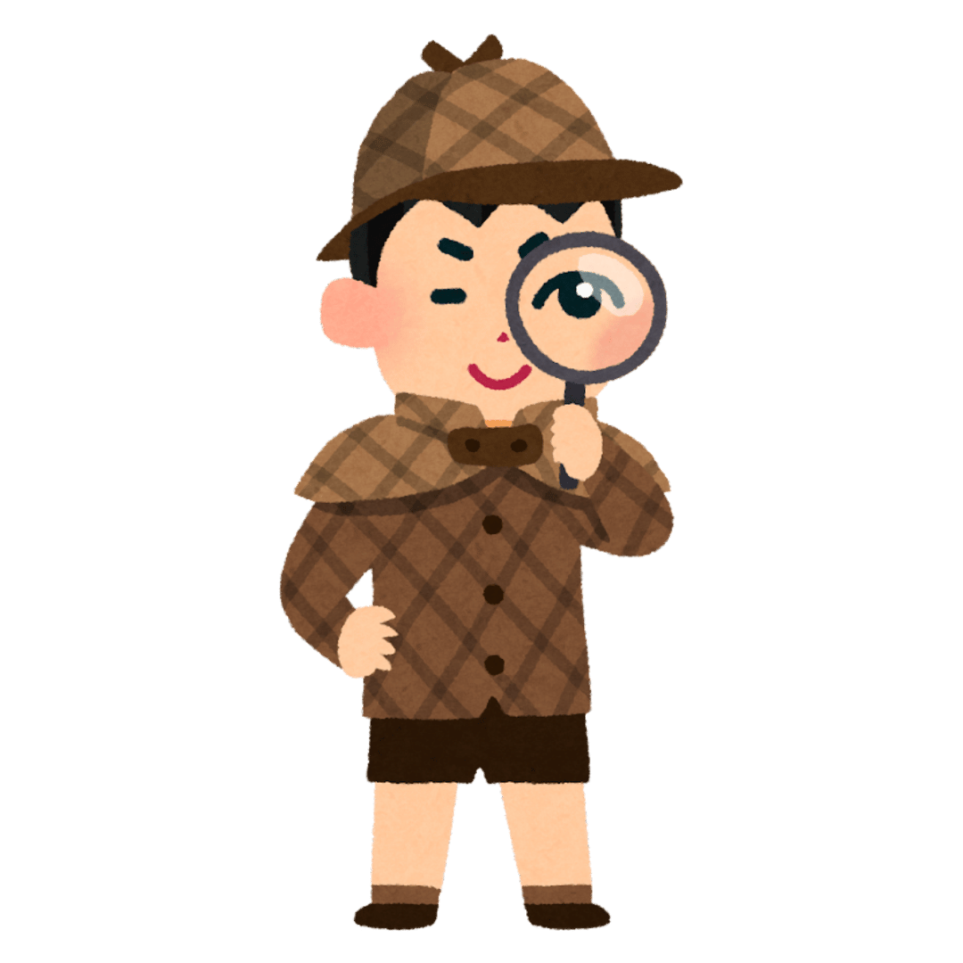
I Spy
What You Need:
Your surroundings
How to Play:
One player looks around and says, "I spy with my little eye, something that is (colour / shape etc)
Other players take turns guessing what it is.
The player who guesses correctly takes the next turn as the "spy."

Slide 13
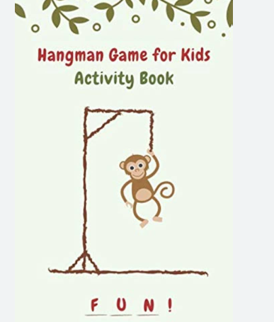
Hangman
What You Need:
Pencil
Paper
How to Play:
Player 1 thinks of a word and draws a blank line for each letter.
Player 2 then guesses a letter to identify the word.
If they guess the correct letter Player 1 writes it on the blank line.
If they guess an incorrect Player 1 draws a body part.
Player 2 must guess the word correctly before the whole body is drawn.

Slide 14
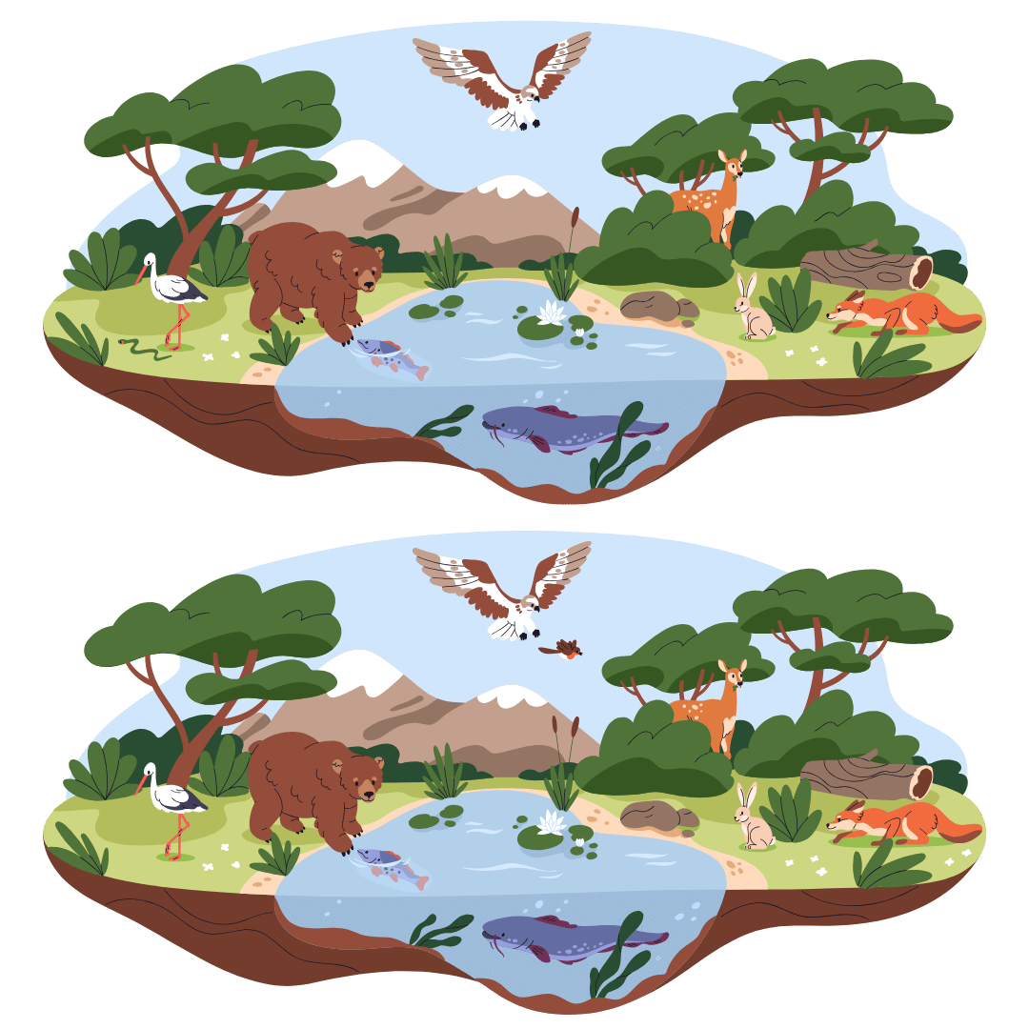
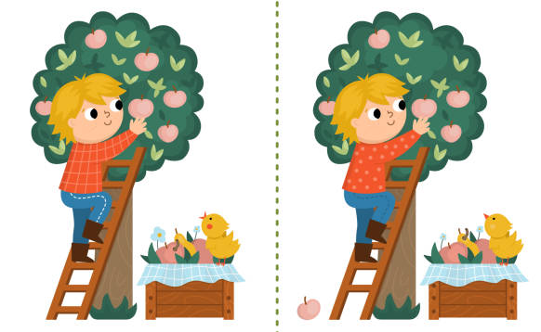
Spot the Difference
There are 10 differences between these images can you find them all?

Slide 15
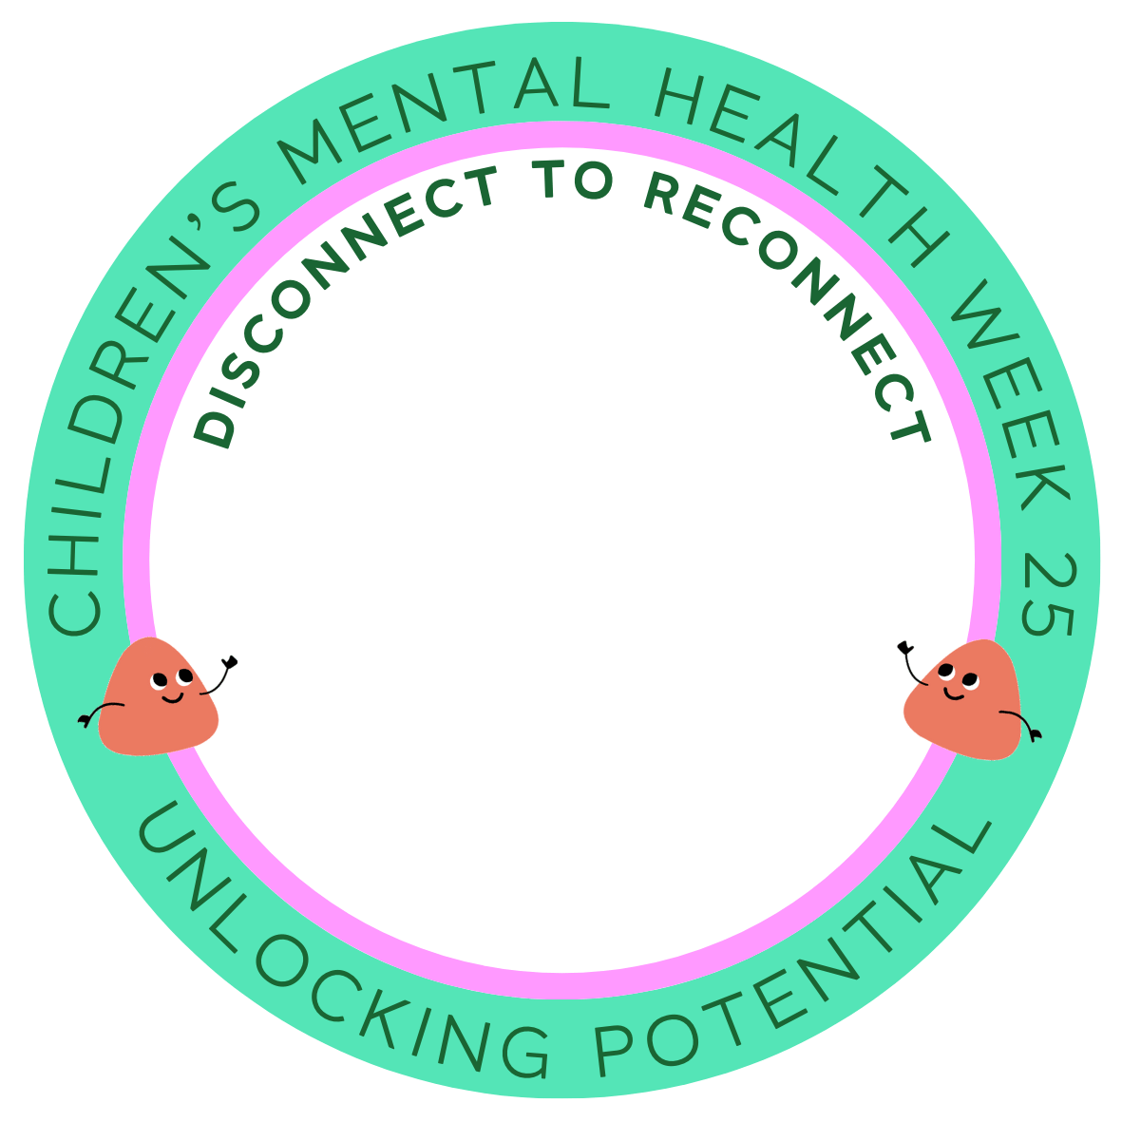
RESOURCES:
Activity 1 – Day Activities
Activity 2 – Who am I?
Activity 3 – Dots & Boxes
Activity 4 – Noughts & Crosses
Activity 5 – I Spy
Activity 6 – Spot the difference

Slide 16
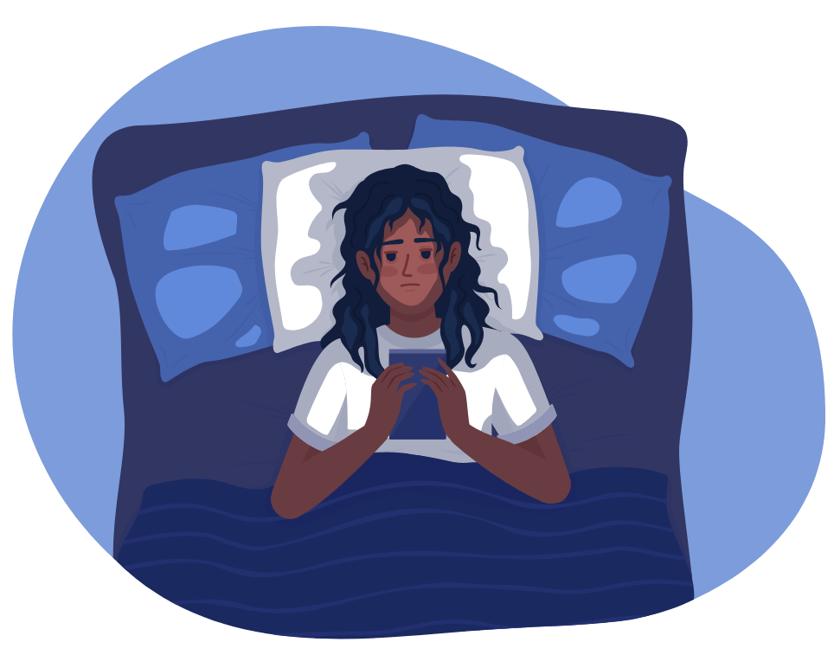
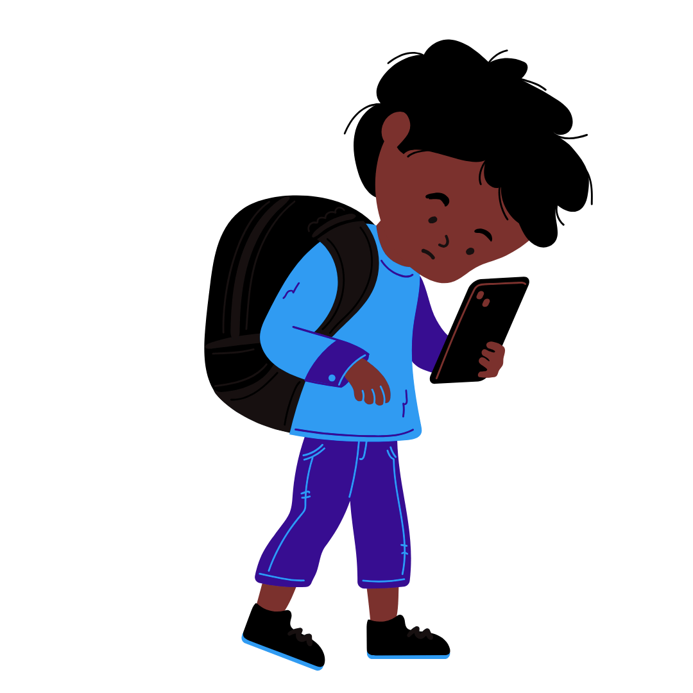
What are unhealthy digital habits?
Spending more than 2 hours a day on your device:
Two hours of screen time is the national recommended daily limit. Exceeding this can negatively impact your attention, social skills, physical and mental health.
Using your device in bed:
This disrupts your sleep, which negatively effects your physical and mental health
Missing out on life because you are on your device:
Sometimes we miss exciting, meaningful moments because we are distracted by our devices, this can sometimes make us feel empty and sad

Slide 17
This competition is designed to help you set boundaries and daily limits for your screen time, lets get creative!

