Slide 1
How can I support and improve my child's handwriting
Ms Sanderson- Friday 17th November 2025

Slide 2
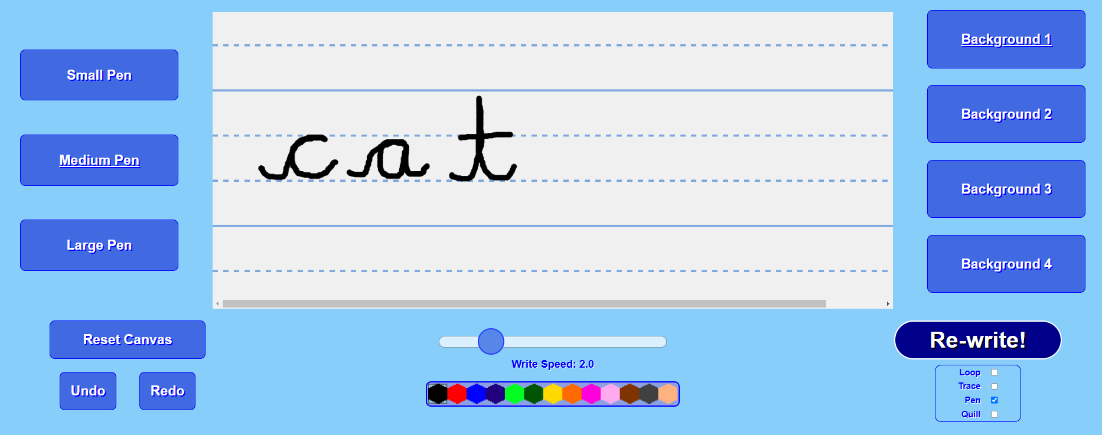
Can you write a postcard to someone who lives far away?

Slide 3
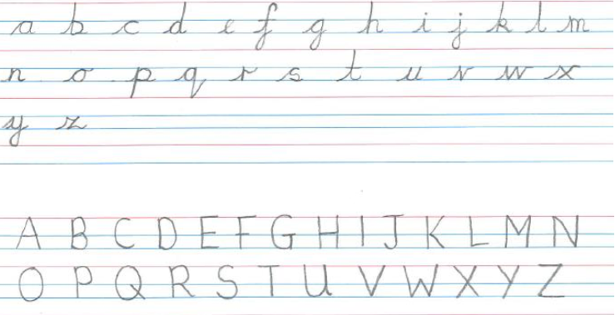
What do we want for our children?
Neat and legible handwriting.
Independent handwriting skills, which they will then apply to their independent writing across the curriculum.
We use a ‘Continuous Cursive Handwriting’ style in order to support children to achieve this.

Slide 4
All the letters can be written without taking the pencil off the page, except “x”. It is quick and fast.

Slide 5
We teach them in this order:
All letters start on the line with an ‘in-stroke’ and finish with an ‘exit-point’.
We do not join capital letters or to a capital letter.

Slide 6
Benefits of cursive handwriting
As each letter begins at the same point on the line there is less opportunity for pupils to reverse their letters.
The motor memory in a pupil’s hands and fingers help him/her to learn new spellings as each word is made up of one movement
One style is taught throughout the school
No need to change or relearn shapes from printed to cursive style
Natural spaces occur between words automatically
Fluency established by early use of joined up letters helps pupils express ideas in written form more easily.

Slide 7
Muscles muscles muscles!
Children need strong hand muscles to write neatly.
They develop these muscles through a range of activities.
What could you do at home?

Slide 8
Fine Motor Skills
Threading activities:
Pincer grip activities:

Slide 9
Drawing patterns helps with fine motor skills:

Slide 10
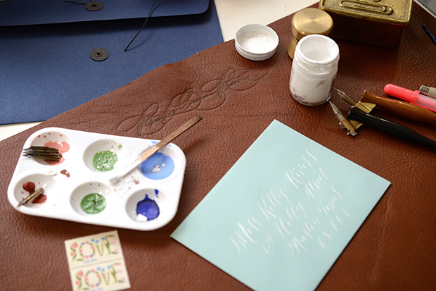
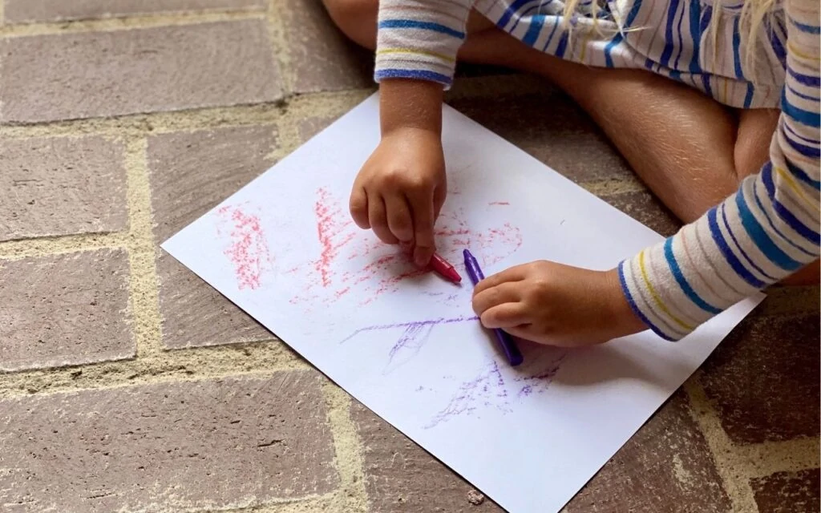
How can you encourage them to practise at home?
Offer a variety of tools: wax crayons both fat and thin, chalks, chunky pencils, felt tips, paint brushes, sand and sticks.
Work on a variety of surfaces: paper (white, black, coloured), blackboard, whiteboard, tracing paper, tin foil, sand paper, shiny card, etc.
Adopt a variety of exploratory positions: lying on the tummy, standing, on all fours, kneeling, sitting and using a vertical surface, e.g. an easel or a wall.
Write in a variety of sizes: big blackboards/whiteboards, old wallpaper, tiny bits of cards, old receipts and paper.

Slide 11
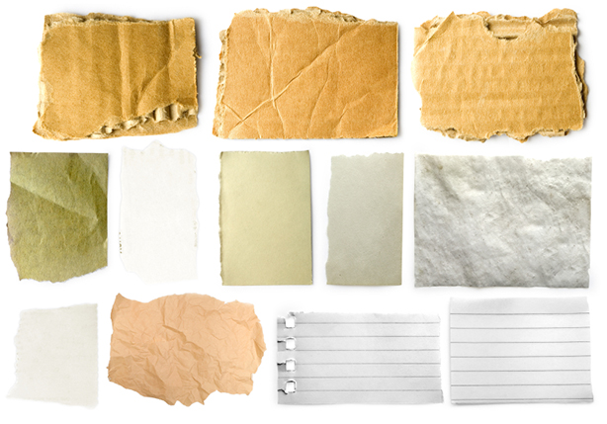
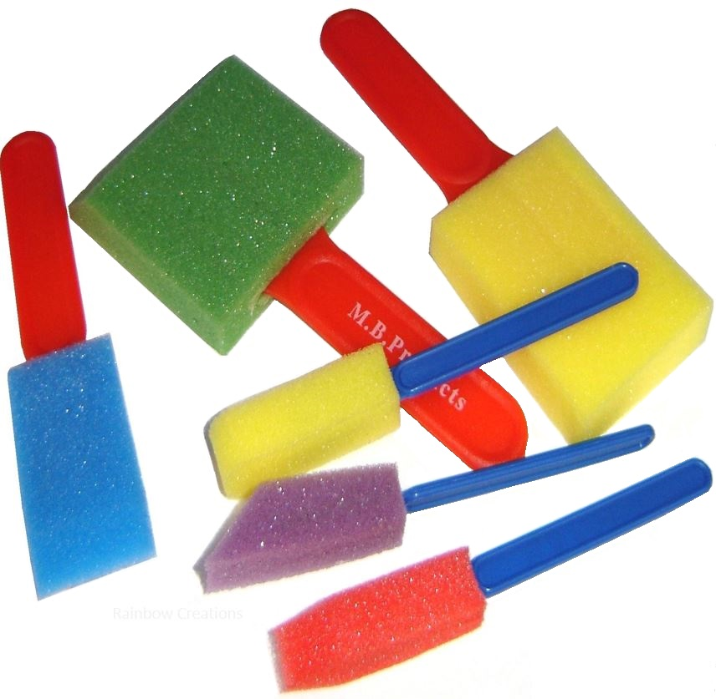
Some ideas!
Write/draw on aluminium foil.
Write/draw on different coloured paper, plain paper, lined paper, colouring books.
Write/draw using a variety of coloured tools including chalk, felt pens, pencils, crayons.
Paint with fingers, sponges, brushes, toys or potatoes.
Rub over stencils or coins using wax crayons, or draw around using pencils.
Colour within boundaries.

Slide 12
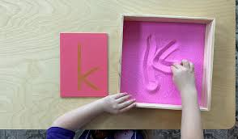
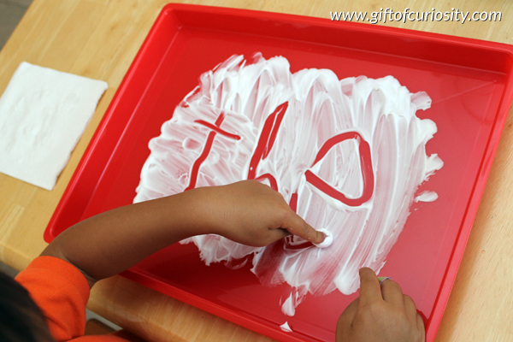
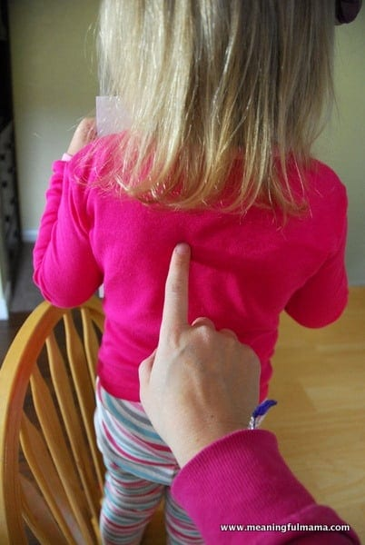
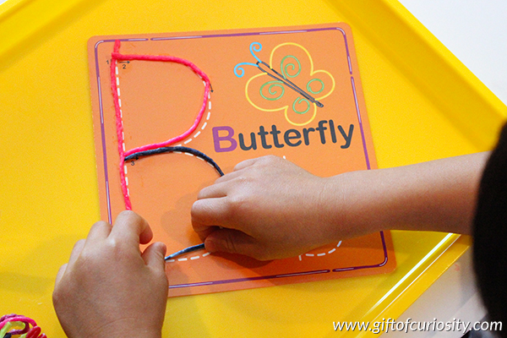
Some ideas!
Draw in a sand tray using fingers, sticks, toys, cars, etc.
Write in shaving foam or cornflour on a table, tray or mirror, using fingers or a brush.
Make shapes with dough, string, wool, wikki sticks, etc.
Draw shapes and letter shapes on a partner’s back.

Slide 13
Children need reasons to write!
Shopping list
Recipes
Letters to family members
Thank you cards
Holiday cards
Pen Pals

Slide 14
Reflection
What will you do next to support your child with their handwriting?

