Slide 1
L.I:To revise how to say what I have in Spanish.
Context : Pets
Week 5
Success Criteria
I can answer a questions about pets.
I can ask questions about pet.

Slide 2

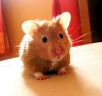

¿Tienes animales?=Have you got animals?
Escucha y repite
Tengo…=I have
1
2
3
4
5
6

Slide 3
¿Tienes animales?
X
Si, tengo…
No, tengo.

Slide 4
Tienes animales?
The wheels on the bus
y
y
Tienes animales?
X
X
No lo tengo.

Slide 5


Practica=practice
Si, tengo.
¿Tienes animales ?
No, tengo.
X
x
x
x
answers

Slide 6
Plenary
Check vocabulary
Ask differentiated and open-ended questions
Discuss what they found easy/difficult
Discuss what strategies they used

Slide 8
L.I: To recognise pets according to their colour in Spanish.
Week 6
Success Criteria;
I can listen and choose the pet with the correct colour.
I can name a pet and it’s colour in Spanish.

Slide 9

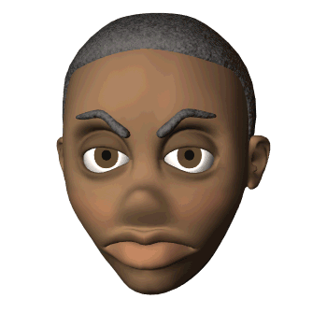

¿Tienes animales?
Practica=practice
Tengo
No tengo
un hamster
un perro
un gato
un pez
une ratón
un conejo

Slide 10
Escucha y repite=listen & repeat
rojo
azul
amarillo
blanco
verde
naranja
negro
marrón
Notes:
Practique animal + couleur: C’est un animal + couleur.

Slide 11
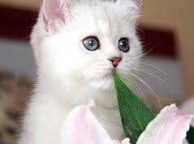
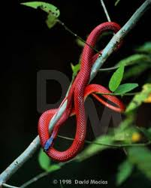
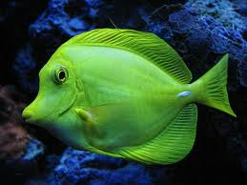
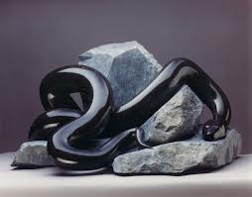
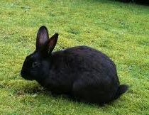
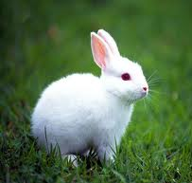
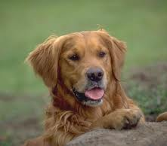
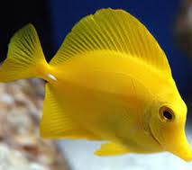
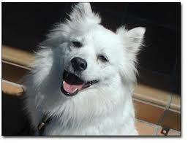
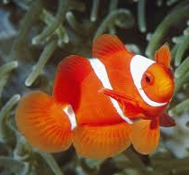
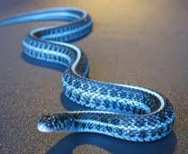
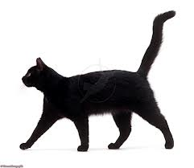
Describe
Una serpiente=snake
Notes:
Practique animal + couleur: C’est un animal + couleur.

Slide 12
¿Qué número es?
1
3
2
4
5
6
7
8
9
10
11
12
Notes:
Practique animal + couleur: C’est un animal + couleur.

Slide 13

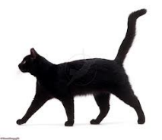
Answers
Notes:
Practique animal + couleur: C’est un animal + couleur.

Slide 14
Plenary
Check vocabulary
Ask differentiated and open-ended questions
Discuss what they found easy/difficult
Discuss what strategies they used

