Slide 1














Revisión de números 0 a 12
Wk 1
Listen & repeat several times
Notes:
Chorus Repetition and graded Q&A. Song

Slide 2
Now count up from memory.
You can go to the previous slide for support.
0 | 1 | 2 | 3 | 4 | 5 | 6 | 7 | 8 | 9 | 10 | 11 | 12

Slide 3
L.I: To count from 13 to 21
Wk 1
Success Criteria:
I can repeat my new numbers with a good Spanish accent
I can listen carefully for my number.
I can count the new numbers in order
Challenge
Can I recognise the numbers randomly and perhaps go beyond 21?

Slide 4










Los números 13 -21
Listen & repeat several times
These numbers begin with dieci..
These numbers all end with “ce”

Slide 5

Los números 11 -21
Listen and read out loud
dieciseis
once
diecisiete
doce
dieciocho
trece
diecinueve
catorce
veinte
quince
Veinte y uno

Slide 6

Now practise saying these numbers out loud.
Practica
These numbers begin with dieci..
These numbers all end with “ce”
11 on.. | 12 do.. | 13 tre.. | 14 cator.. | 15 dieci.. | 16 | 17 | 18 | 19 | 20 | 21
-ce
dieci-

Slide 7

Escucha y toca
Listen, touch a number then click to see if you got the correct answer each time.

Slide 8
Practica con tu compañero
Now practise again with a sibling or adult saying these numbers out loud.
11 on.. | 12 do.. | 13 tre.. | 14 cator.. | 15 dieci.. | 16 | 17 | 18 | 19 | 20 | 21
-ce
Dieci-

Slide 9


Practica en grupo
Ask a sibling or adult to test you. Write your answers on a sheet of paper.
16
11 | 12 | 13 | 14 . | 15 . | 16 | 17 | 18 | 19 | 20 | 21
-ce
dieci-

Slide 10
RESOURCES
DOUBLED SIDED for pupils

Slide 11
Pupil copy
Escucha y toca

Slide 12
Pupil copy
Practica
These numbers begin with dieci..
These numbers all end with “ce”
11 on.. | 12 do.. | 13 tre.. | 14 cator.. | 15 dieci.. | 16 | 17 | 18 | 19 | 20 | 21
-ce
dieci-

Slide 13
Los números 0 - 21
Teacher copy
0
zéro
11 once
12 doce
13 trece
14 catorce
15 quince
1
2
3
4
5
6
uno
dos
tres
cuatro
cinco
seis
16 dieciseis
17 diecisiete
18 dieciocho
19 diecinueve
20 veinte
21 veintiuno
7
8
9
10
siete
ocho
nueve
diez
Notes:
Link sound to text

Slide 15
L.I: To practise my numbers from 13 to 21 in Spanish
WK 2
Success Criteria:
I can sing/count my numbers in order
I can say the number of spots on my dice.
Challenge
I can add the number of spots on more than one dice.

Slide 16
0 | 1 | 2 | 3 | 4 | 5 | 6 | 7 | 8 | 9 | 10 | 11 | 12
13 | 14 | 15 | 16 | 17 | 18 | 19 | 20
21
Listen & practise counting up to 21.
Listen and touch the correct age.
Cúantos años tienes ?

Slide 17
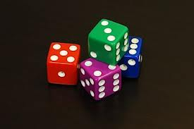
Vamos a contar
Practise your numbers by rolling 1, 2 or 3 dice. Or click the link to go online.
https://www.online-stopwatch.com/chance-games/roll-a-dice/
11 | 12 | 13 | 14 | 15 | 16 | 17 | 18 | 19 | 20 | 21
-ce
dieci-

Slide 18
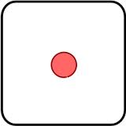
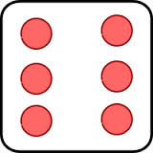
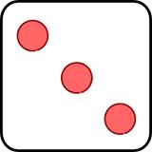
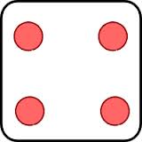
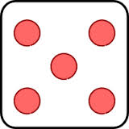
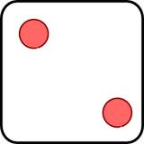


Las matemáticas
Conta los lunares
Click twice and then count the dots.
Listen to the maths sentence can you say the answer before me!.
más = add
Igual = equals
Notes:
Place dice in number sentence

Slide 19
Las matemáticas
Conta los lunares
Click twice and then count the dots.
Listen to the maths sentence can you say the answer before me!.
más
igual

Slide 20

Now creates sums with a sibling or adult using the dice on a piece of paper – try saying the maths sentence out loud. Listen to the example.
más
igual

Slide 21
RESOURCES
DOUBLED SIDED for pupils

Slide 22
Pupil copy
Practica con tu compañero
11 on.. | 12 do.. | 13 tre.. | 14 cator.. | 15 dieci.. | 16 | 17 | 18 | 19 | 20 | 21
-ce
dieci-

Slide 23
Los números 0 - 21
Pupil copy
0
zéro
11 once
12 doce
13 trece
14 catorce
15 quince
1
2
3
4
5
6
uno
dos
tres
cuatro
cinco
seis
16 dieciseis
17 diecisiete
18 dieciocho
19 diecinueve
20 veinte
21 veintiuno
7
8
9
10
siete
ocho
nueve
diez
Notes:
Link sound to text

Slide 24
Los números 0 - 21
Teacher copy
0
zéro
11 once
12 doce
13 trece
14 catorce
15 quince
1
2
3
4
5
6
uno
dos
tres
cuatro
cinco
seis
16 dieciseis
17 diecisiete
18 dieciocho
19 diecinueve
20 veinte
21 veintiuno
7
8
9
10
siete
ocho
nueve
diez
Notes:
Link sound to text

