Slide 1


L.I. To learn how to ask politely for classroom items
WK5
Success criteria:
I can listen and choose the correct object.
I can ask politely for class objects in Spanish.
.

Slide 2
En La Escuela
Mis cosas del colegio
Classroom language and objects

Slide 3

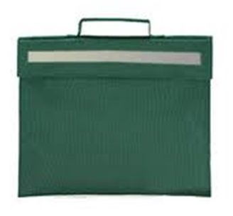


Mis cosas del colegio
Listen and repeat. Add an action which represents each object.
Person 1: Say the word
Person 2: Mime the action
Swap roles
Listen and touch
Notes:
Listen and repeat, diff. Q&A

Slide 4
Mis cosas del colegio
un lapíz
un bolso
un libro
Notes:
Pupils practise phrase.

Slide 5
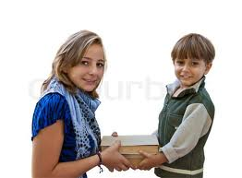

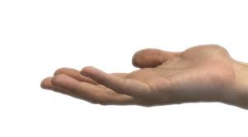
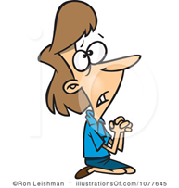

Listen to the words and follow the pictures.
Listen and repeat.
Try saying the phrase on your own.
Notes:
Passe-moi un/une … s’il te plait

Slide 6
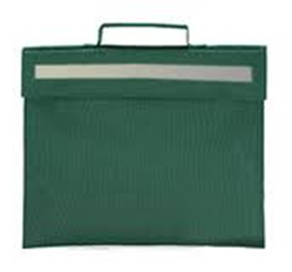
Listen to the words and follow the pictures.
Listen and repeat.
Try saying the phrase on your own.
Notes:
Passe-moi un/une … s’il te plait

Slide 7
Listen to the words and follow the pictures.
Listen and repeat.
Try saying the phrase on your own.
Notes:
Passe-moi un/une … s’il te plait

Slide 8




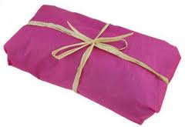
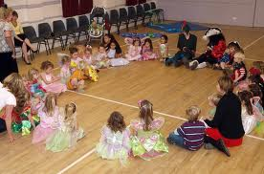
Pásame un /una por favor
Adult - Place items on the floor. Play music, pass a ball / toy / bean bag. Stop the music - ask for an item using a Spanish phrase.
Child – pass the correct object
Notes:
Play music, pass the bean bag. Music stops child responds to “Pasame”

Slide 9
Resources
Book, pencil and bag to be used
In a circle.
Print off class poster

Slide 10

Mis cosas del colegio
Pásame …
un bolso
un libro
un lápiz
…por favor!
Notes:
Pupils practise phrase.

Slide 12
L.I. To create my own polite sentences using classroom items.
Sprg 2 Wk 6
Success criteria:
I can name my 3 class objects in Spanish.
I can use my numbers to ask for more than one object.
I can put my picture sentence in the right order.

Slide 13














Los números 0 a 12
Notes:
Practise numbers – Print 5 different colours

Slide 14
Mis cosas del colegio
Revision – listen and repeat
Notes:
Listen and repeat, diff. Q&A

Slide 15
Revision – listen and repeat adding actions.
Notes:
Passe-moi un/une … s’il te plait

Slide 16
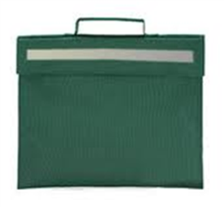
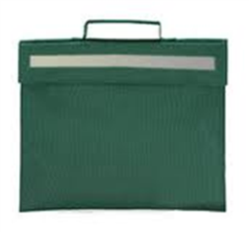
Revision – listen and repeat adding actions.
Notes:
Passe-moi un/une … s’il te plait

Slide 17


Revision – listen and repeat adding actions.
Notes:
Passe-moi un/une … s’il te plait

Slide 18

Count the number you see on your fingers before saying the phrase.
Say the phrase.
Listen
Were you correct?
Notes:
Passe-moi un/une … s’il te plait

Slide 19
Count the number you see on your fingers before saying the phrase.
Say the phrase.
Listen
Were you correct?
Notes:
Passe-moi un/une … s’il te plait

Slide 20
Count the number you see on your fingers before saying the phrase.
Say the phrase.
Listen
Were you correct?
Notes:
Passe-moi un/une … s’il te plait

Slide 21
Resources
Print off A3 - paper with hands – 1 between 2
Print off A4 - number and object – 1 sheet between 2
as needed – cut into cards.

Slide 22
Haz una frase!

Slide 23
Notes:
Whole class repetition. Passe moi deux crayons s’il te plaît. Change numbers – ask individuals

Slide 24
Notes:
Whole class repetition. Passe moi deux crayons s’il te plaît. Change numbers – ask individuals

Slide 25
Notes:
Whole class repetition. Passe moi deux crayons s’il te plaît. Change numbers – ask individuals

Slide 26
Notes:
Whole class repetition. Passe moi deux crayons s’il te plaît. Change numbers – ask individuals

Slide 27
Notes:
Whole class repetition. Passe moi deux crayons s’il te plaît. Change numbers – ask individuals

Slide 28
Notes:
Whole class repetition. Passe moi deux crayons s’il te plaît. Change numbers – ask individuals

