Slide 1
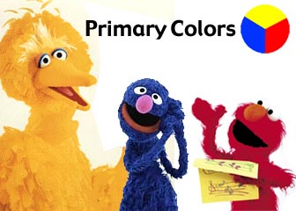
L.I.: To use adjectives in Spanish.
Context: colours
Success Critieria
I can read colours using my Spanish sounds
I can use my detective strategies to remember vocabulary
I can name at least 6 colours in Spanish

Slide 2
Vamos a leer=read
LL =
Es..
Rojo
Verde
Amarillo
Azul
Marron
Rosa
Negro
Naranja
Blanco
Gris
Notes:
reading.

Slide 3
¿Qué falta?=What’s missing?
Notes:
3
3
What’s missing?

Slide 4
Círculos y cruces
O X

Slide 5
Optional game:
http://www.purposegames.com/game/749

Slide 6
RESOURCES

Slide 7
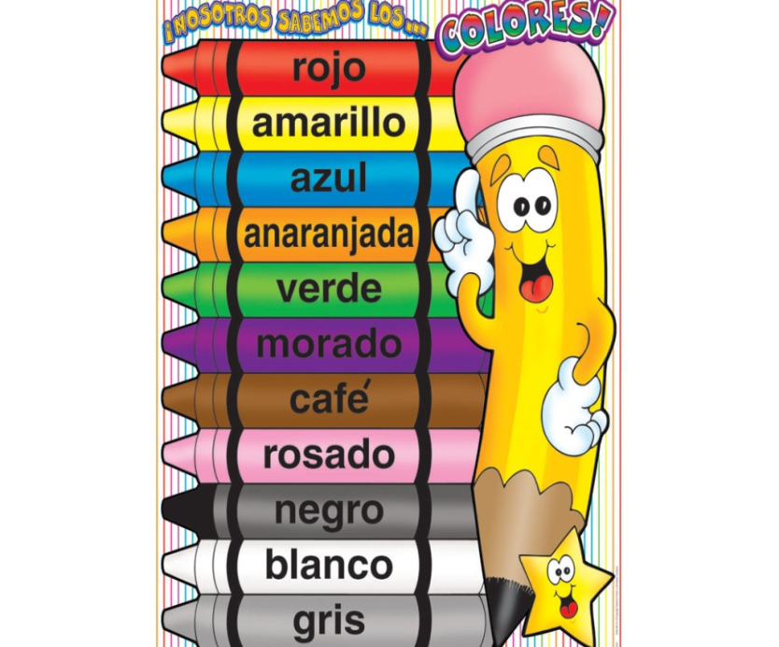
L.I. To use adjectives in Spanish. Context: colours
Success criteria:
I can use my detective strategies to remember vocabulary.
I can name at least 6 colours in Spanish
I ask the colour of an object
CT OA Indep
Self Assessed Peer Assessed Teacher Assessed
marron
rosa

Slide 9
Wk6
L.I: To link sounds and spellings in order to read and write in Spanish.
Context: Colours
Success Criteria:
I can say colours in Spanish.
I can write a description of a book using the colour (adjective) after the object (noun).
Challenge 1
I can write my colour sentence using different objects.
I can write my sentence using the negative

Slide 10
¿De qué color es?
Notes:
10
10
What colour is it?

Slide 11
¿Qué es?¿De qué color es?
Es …
un libro
rojo

Slide 12
Competición:
Es …
Notes:
Toca=touch the book you hear

Slide 13
answers:
Es …
Notes:
Toca=touch the book you hear

Slide 14
¿Es un libro….?
Si es./No es.
Adivina el color=guess the colour
Notes:
Guess the object and colour? Score points on whiteboard

Slide 15
Escribe=write the sentences
¿De qué color es?
1.-
2.-
3.-
The colour comes after the object!
4.-
5.-
6.-
7.-
8.-
9.-
1.-Es un libro rojo.
CHALLENGE 1: Write some more sentences using: un lápiz, un sacapuntas, un cuaderno, un estuche
1.-Es un sacapuntas amarillo.

